Slide 1


Bike-Tracks App Development
Team 8
Yuyuan Wu | Aaron Fan | Zixuan Su | ShanLi | Youlun Li | Sura Liu | Yash Sood

Slide 2
Presentation Content
1.Introduction and Motivation
2.Details of Implementation
3.APP Demo
4.Project Conclusion

Slide 3
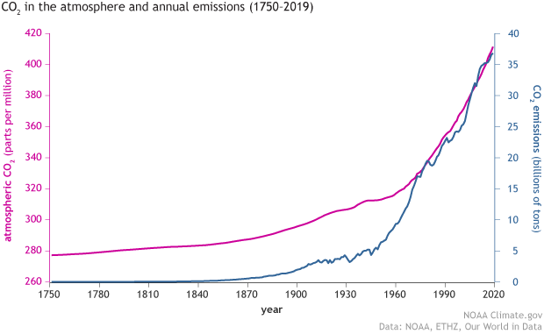
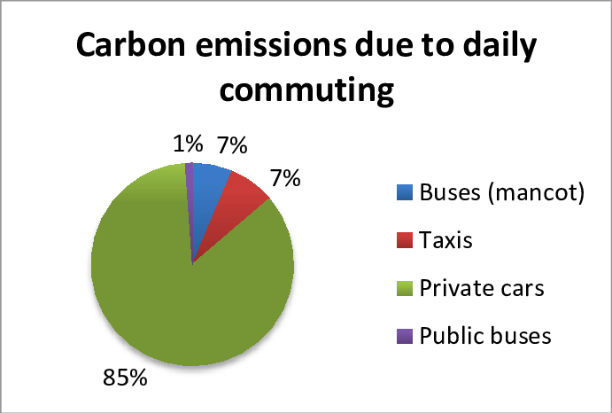
Project Introduction(Yuyuan)
earth’s carbon dioxide concentration is increasing
a lot to do with the use of energy-intensive vehicles
encourage people to choose low-carbon ways to commute
No mobile application is designed for track daily transportation to encourage low-carbon commuting until now
urgent need for developing an app
how to distinguish between modes of transportation is the difficulty
Distinguish need a great amount of data
Our group is committed to developing a mobile app to collect users' commuting data

Slide 4
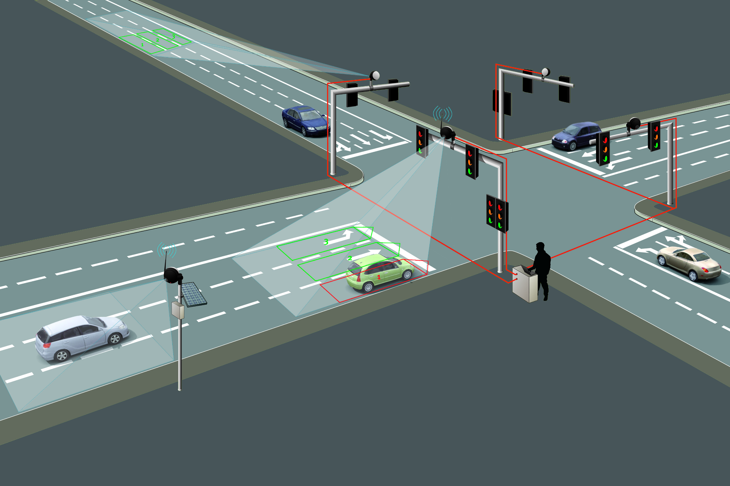
Project Motivation (Yash Sood)
Existing Systems
Video Analysis Systems
EMV Chip Embedded into cars (used in ERP System)
Tagging required, same tag cannot be used for different vehicles types.
Proposed System
Use of Smartphone based sensors
Computational load and data storage done locally
Use of machine learning algorithms to determine vehicle types.
No tagging required, adaptable system.

Slide 5
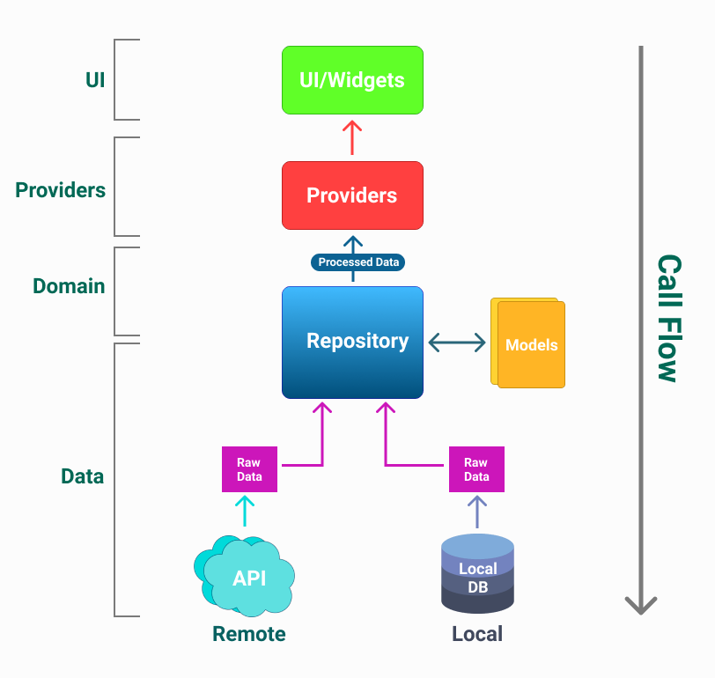


Project Motivation (Yash Sood)
Solution Novelty
Front-end and Back-end Development done with Flutter.
Allowing for cross-compatibility
App data stored locally, allowing for computation and analysis to occur locally
Internet Access Not required, as all sensors are locally available

Slide 6
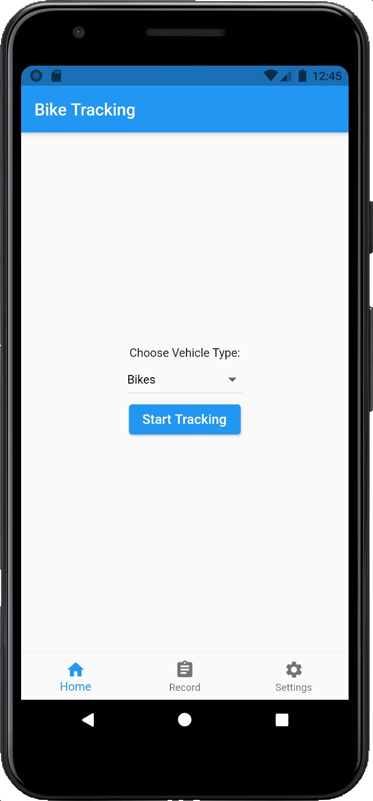
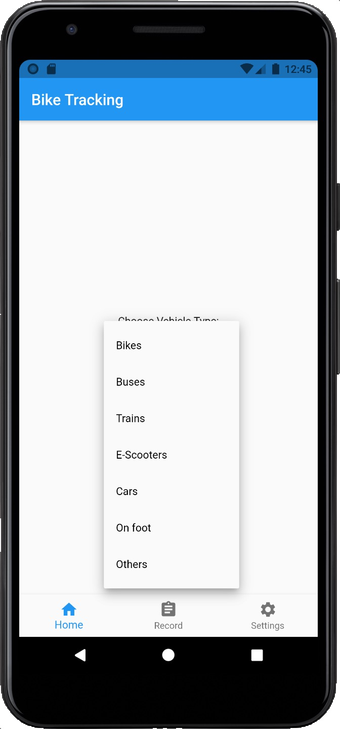
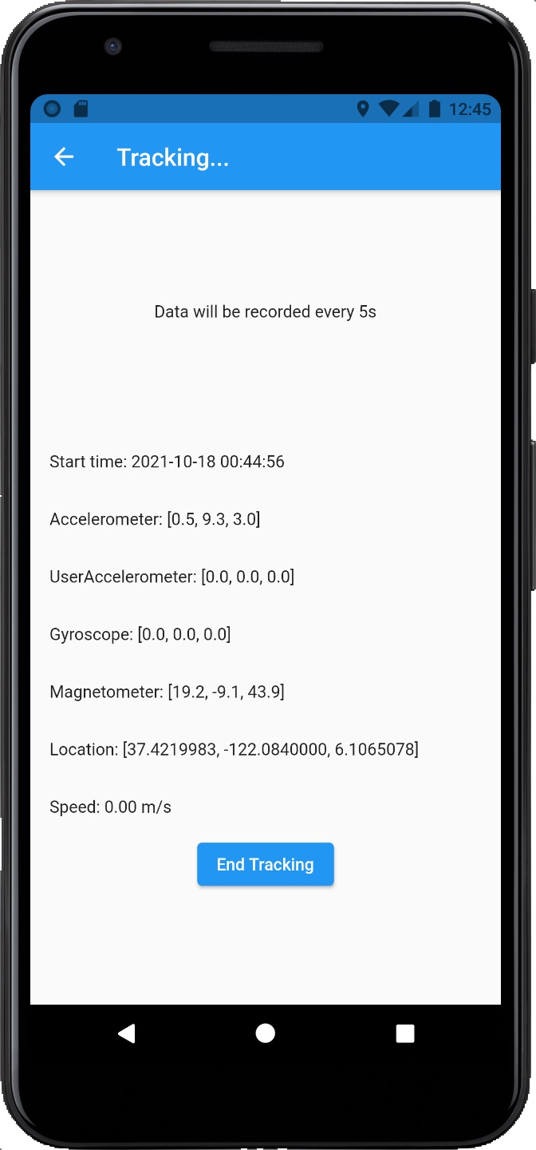
Project designs - UI

Slide 7
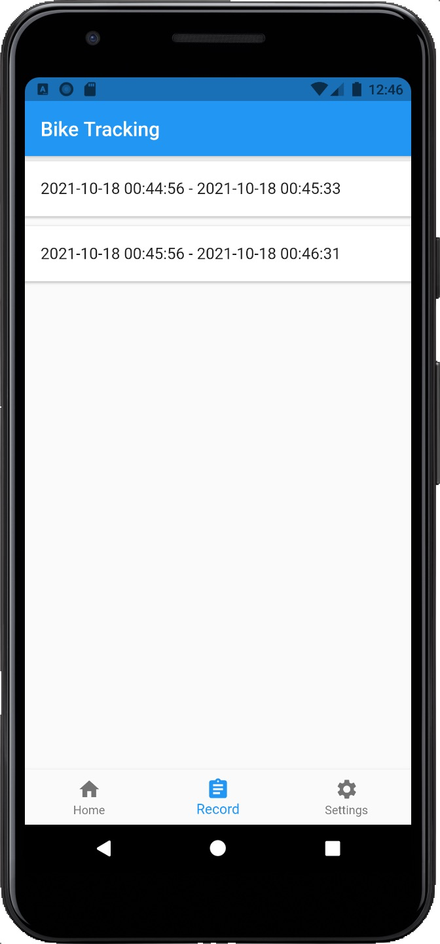
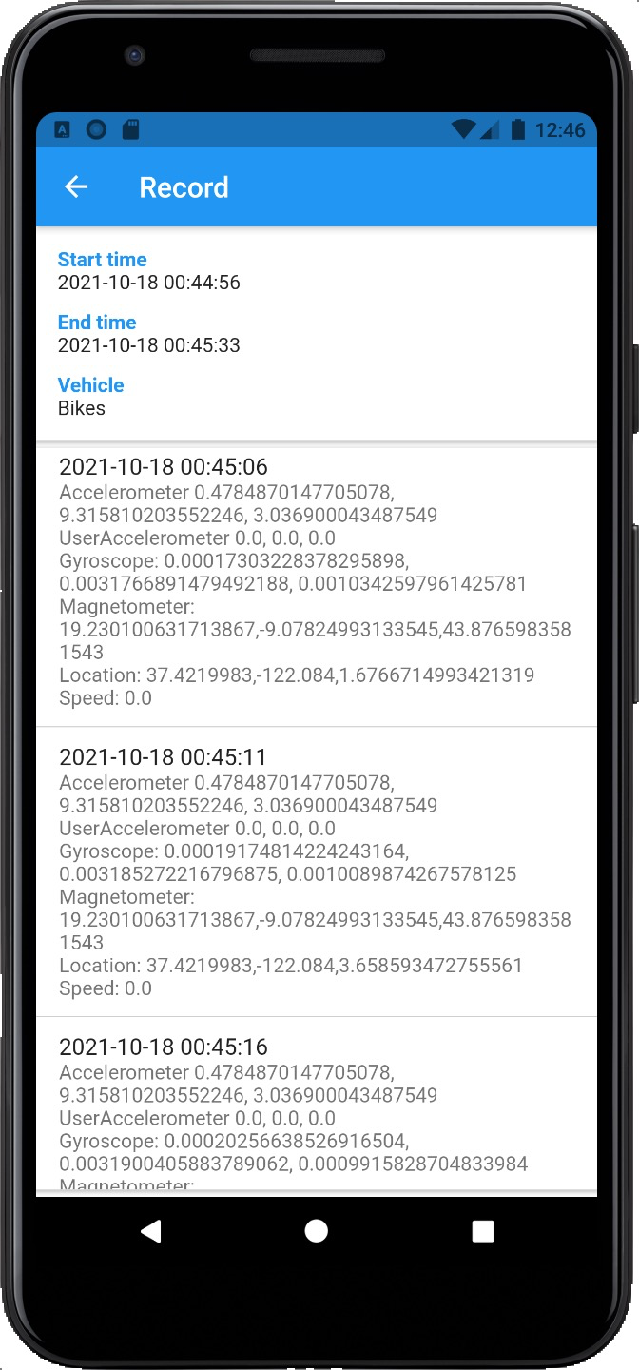
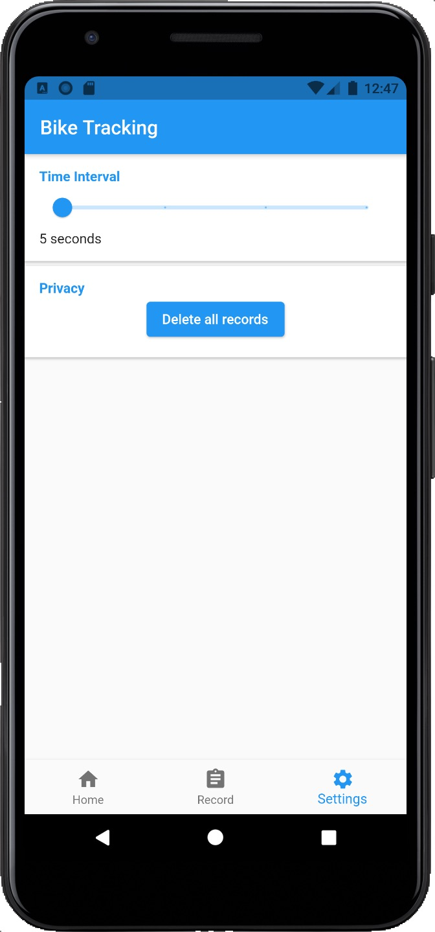
Project designs - UI

Slide 8
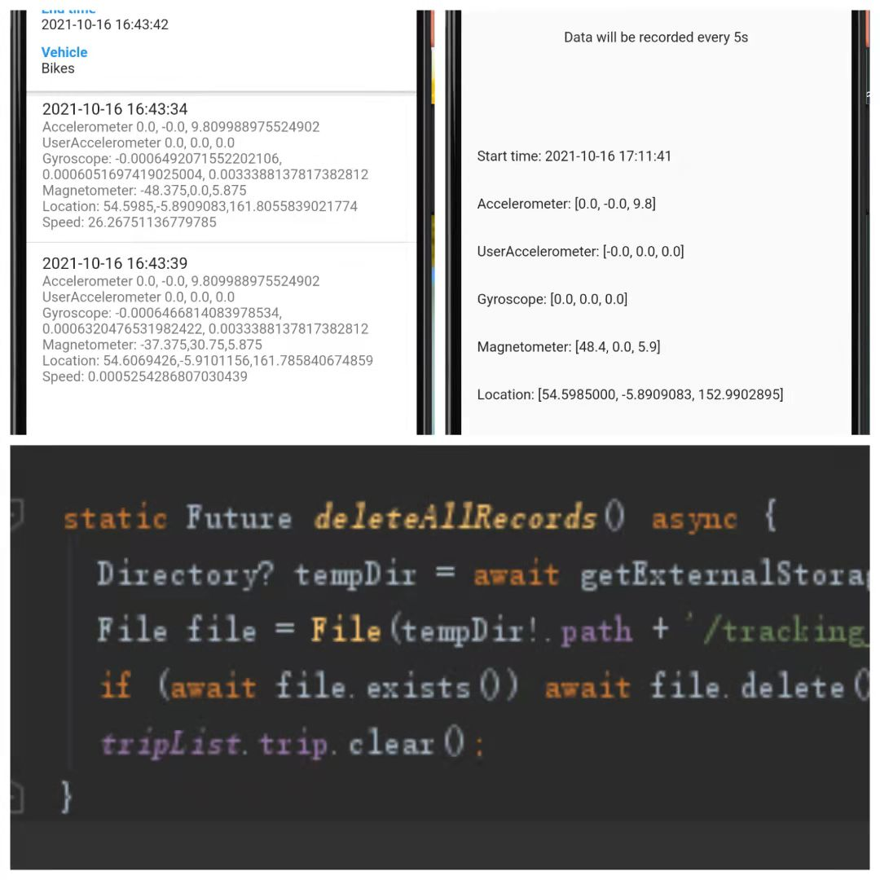
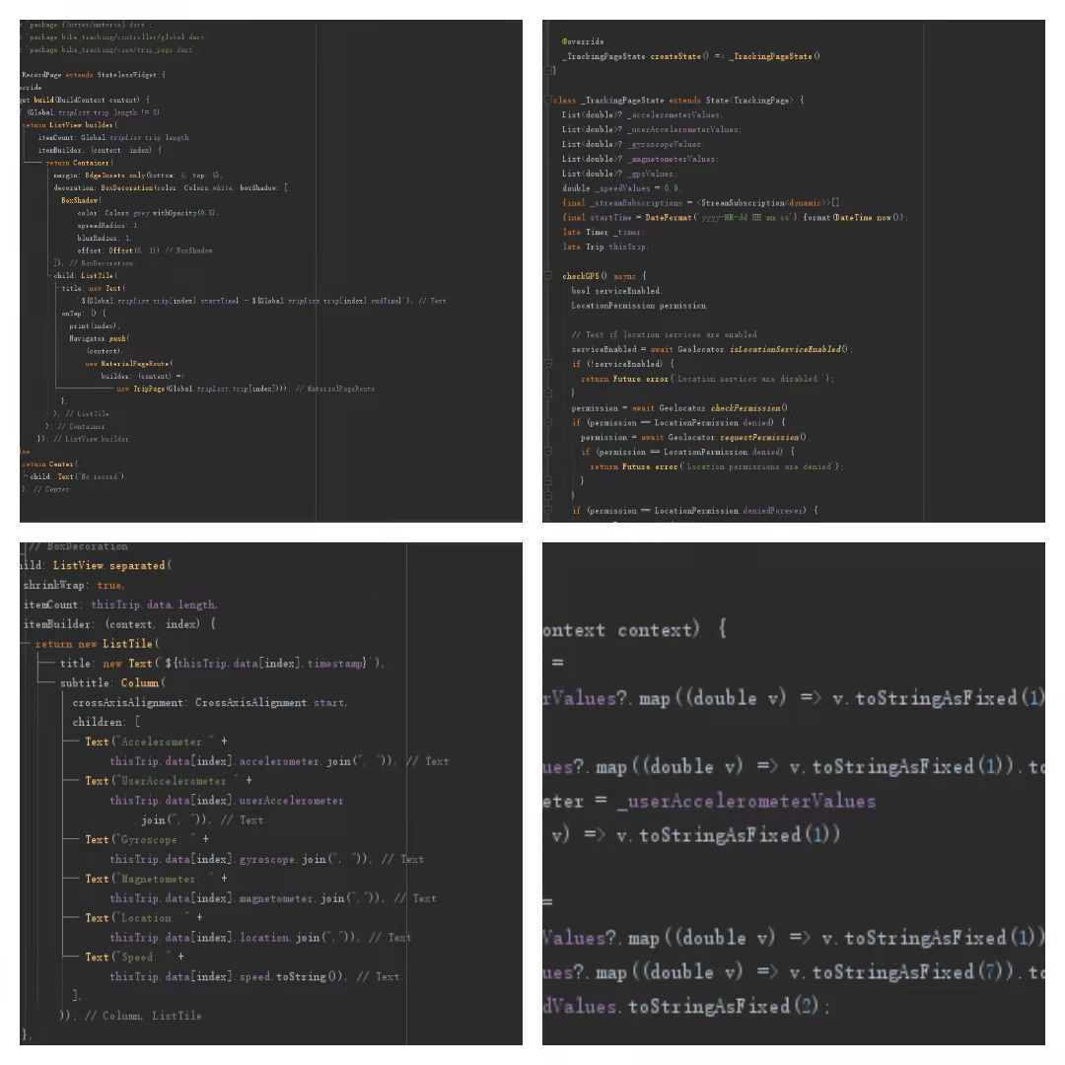
Back-End Implementation

Slide 9

Project Demo Video(Sura Liu)

Slide 10


Conclusion (Zixuan Su):
Goals achieved:
Goals did not achieve:
1: User are able to start or end tracking whenever they want.
2: User are able to delete the pass records.
3: User are able to see all the past record details in the record page.
4: User can see real-time tracking details after they start tracking.
5: The tracking detail is readable by the user (JSON format).
6: User can change the tracking frequency as they wish.
7: User are able to choose the vehicle type they used before they start tracking.
8: The datafile that we store can be found in the filesystem on users’ own device.
1: Our application cannot distinguish the vehicle type automatically.
2: Our application do not have IOS version.

Slide 11
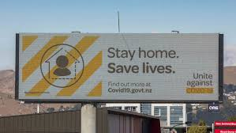

Non-technical challenge: (Zixuan Su)
Due to the Lockdown everything seems like frozen and we were not that productive.
Everyone has different courses, it is hard to arrange the meeting time that suits everyone.
Too many assignments due at the same time so we did not have enough time to work on the project.
Technical challenge: (YouLun Li)
Hard to build the IOS version application because of the closed source systems. It was hard to store, fetch and modify those data.
Map API cannot be added in since the application is supposed to use offline

Slide 12
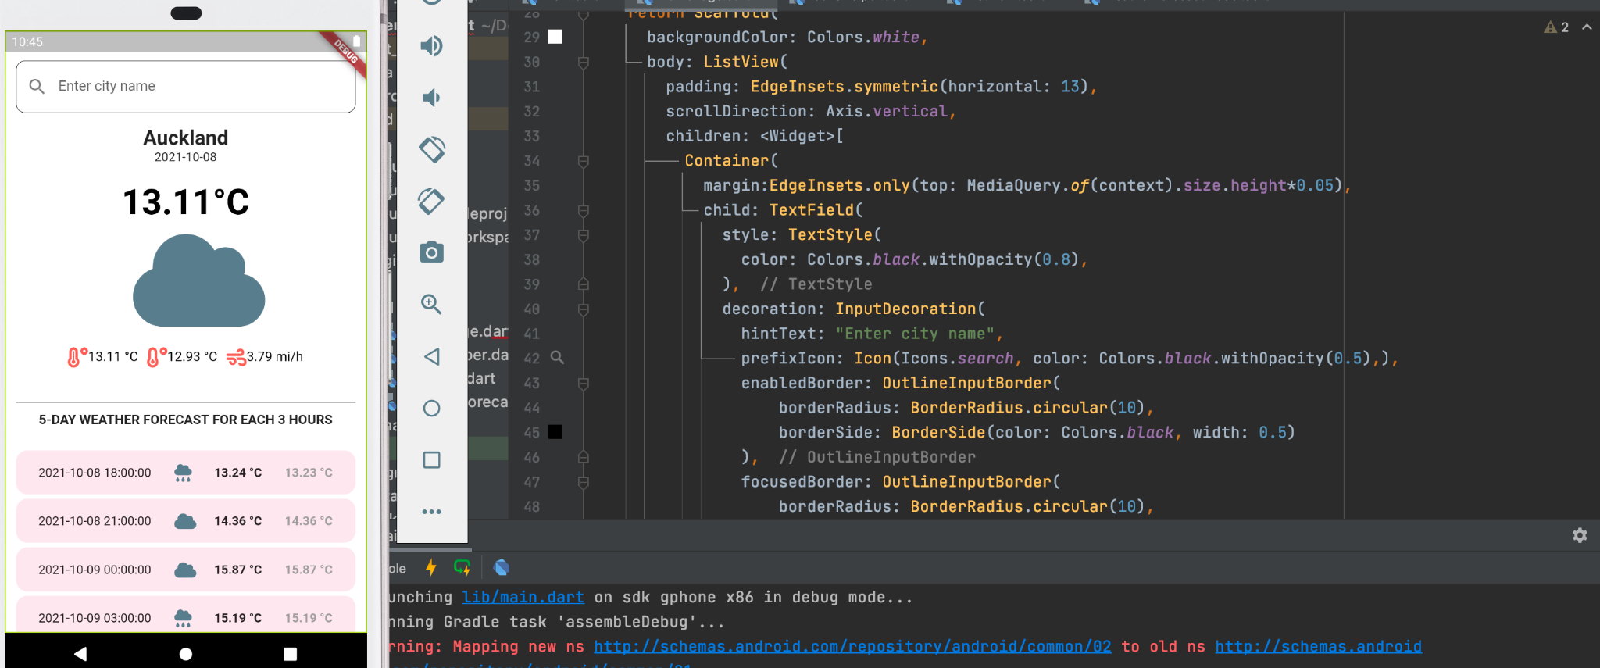
Future Directions
Achieved !
Networking Features
Weather forecast
Map tracking
Personalise profile setting

Slide 13
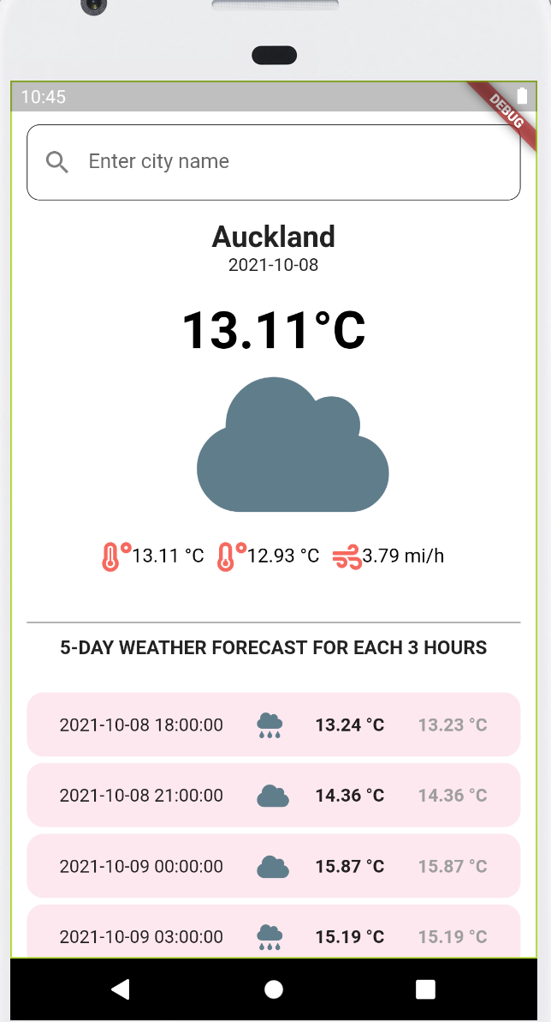
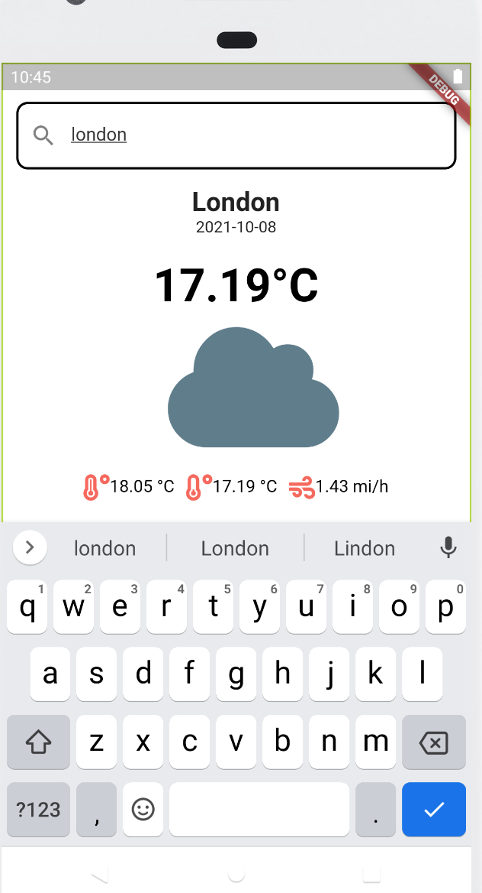
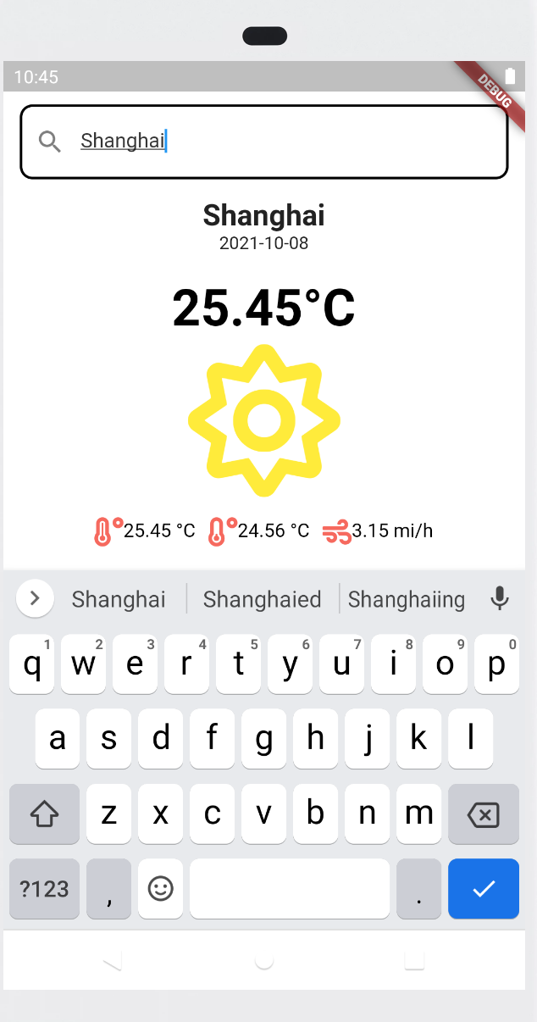
Weather Forecast
Insight deliverable
Weather infor
Wind speed
Intuitive icon

Slide 14
Thank You For attending our presentation.
-Team 8

